Slide 1
Text Mining with Naïve Bayes
By Franklin Chou

Slide 2
Today’s Agenda
Basic Probability Concepts
Conditional Probability
Intuitive understanding of Bayes Theorem
Bayes Theorem in Text Mining
TF-IDF

Slide 3
Conditional Probability
Conditional Probability is a probability based on some observed evidence or information.
Given that I am an non-smoker, what are the odds of me suffering a heart attack in the next year?

Slide 4
Joint probability
The probability of two events happening
P(a AND b)
Probability both a and b are true
Equivalent to p(a) p(b|a)
If a and b are truly independent, the =p(a)*p(b)
Independence means that one event does not affect the chances of the other event happening in any way.

Slide 5
Scenario
You are at a wedding party. There are three families there, the Jones, the Smiths and the Dodgers.
You are asked to make a toast. Someone who has made a very generous gift of a black Ferrari to the newlyweds.
Because you had been concentrating on carving the squab on the stick on the waiters plate instead of taking the whole squab on the stick onto your own plate, you were not paying attention to the talking. And you were always bad with names.

Slide 6
Scenario
Thankfully for you, you are decent with numbers. You recall that there were 12 Jones, 27 Smiths and 61 Dodgers.
Q1: Who should you make out the toast to, and what are the chances that you would have to buy a black Ferrari for the angry and embarrassed bride?
You see the subject of the toast is female. A summary of the guest list distribution is as follows.

Slide 7
 | Male | Female | Total
Jones | 4 | 8 | 12
Smiths | 12 | 15 | 27
Dodgers | 59 | 2 | 61
Total | 75 | 25 | 100
Q2: What is the probability that the toasted is a Dodgers?
Q3: What name should you toast to?
Q4. The male Dodgers are expert wrestlers, and like to exhibit their skills. Your squab on a stick hits a man. What is the probability that you will have to be driven home in an ambulance?

Slide 8
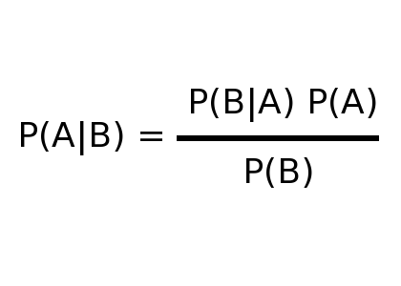
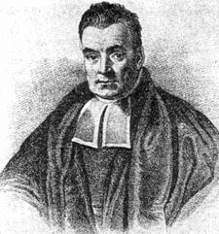
Bayes Theorem

Slide 9
Naïve Bayes within Text mining
Given that we see words w1, w2, w3 … wN, what is the likelihood that the current document belongs to category X?
Assume independence amongst all variables
P(document is obituary| contains the word “ambulance”, “squab”, “ferrari”)
“John died violently in a bizarre incident involving an ambulance, a ferrari and a squab on a stick”

Slide 10

Word frequencies
1. Find the frequency that each word shows up in different categories
I see Ferrari in 50 documents, 40 of which are orbituaries. There are 100 documents in total, with 60 orbituaries.
P(orbituary)=.6
P(ferrari)=.5
P(orbit|ferrari)=$\frac{\text{P}\text{(}\text{ferrari}\text{|}\text{orbit}\text{)}\text{P}\text{(}\text{orbit}\text{)}}{P(ferrari)}$
=2/3*.6/.5=.8

Slide 11

Combining Frequencies
$\frac{a∗b∗c}{a∗b∗c+(1−a)(1−b)(1−c)}$
Given the “somberness” of the words ambulance, ferrari and squab are as follows.
.6, .8, .3
The probability that the document we are reading is an orbituary is ?

